Slide 1


HEARTILY
WELCOME
To Our
HEALTH AWARENESS
PROGRAM

Slide 2


ASCLEPIUS WELLNESS PRIVATE LIMITED
A natural way of improving your healthy & Wealthy Lifestyle.

Slide 3
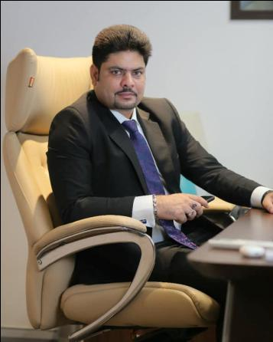
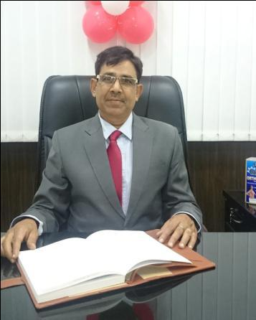

Director
Mr.Sanjiv Kumar
Mr.Mamchand Raipuria
Managing Director and Chief Executive Officer
Finance & Operational Director

Slide 4
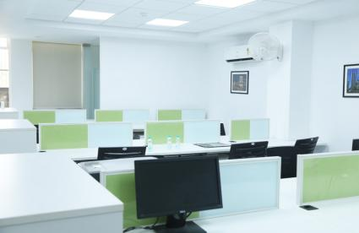
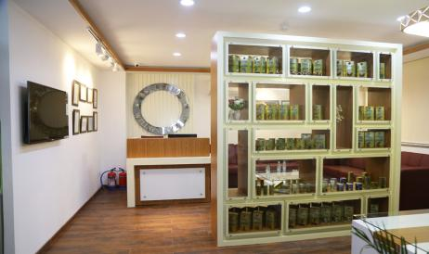
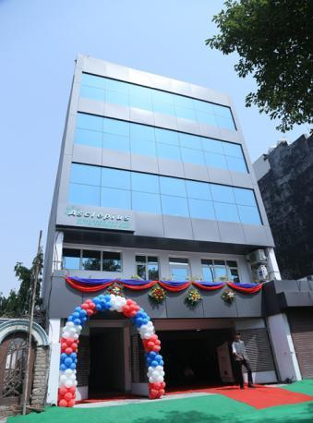
HEAD OFFICE
PLOT NO-18, POCKET-8, BLOCK-C,
SECTOR-17, DWARKA, SOUTH-WEST DELHI
PIN-110075
# 011-28033739
www.asclepiuswellness.com
info@asclepiuswellness.com

Slide 5
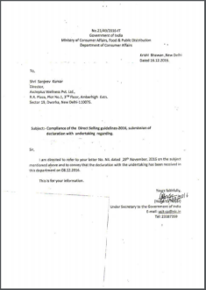
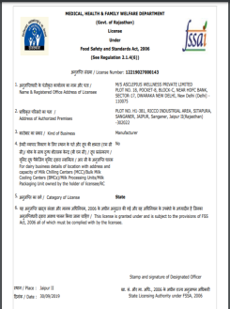
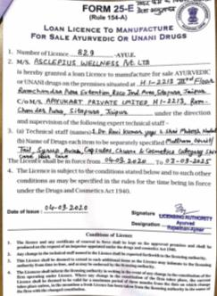
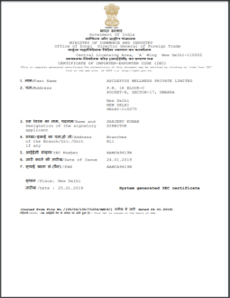

CERTIFICATIONS & LICENCES
Acknowledgement – MCA
FSSAI LICENCE
Manufacturing
License
Import Export Certificate
Incorporation Certificate

Slide 6




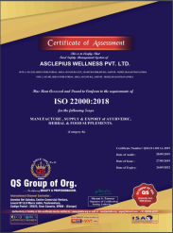

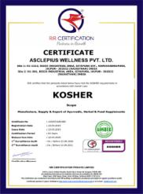


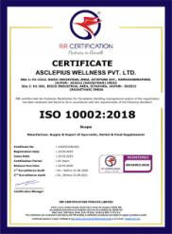
CERTIFICATIONS & LICENCES

Slide 7
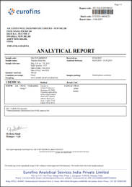
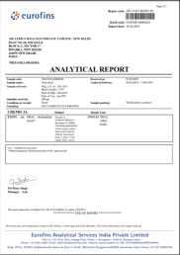
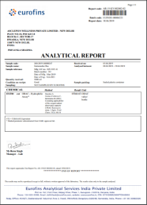
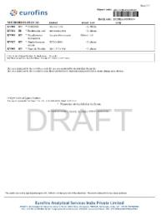

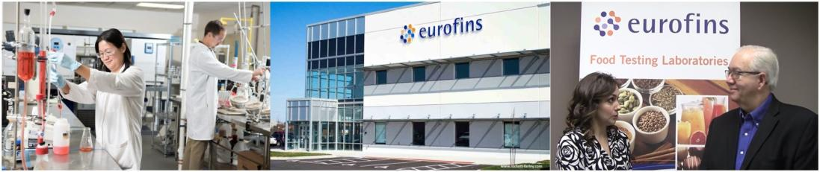
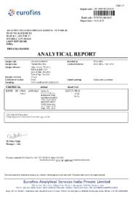
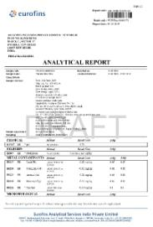
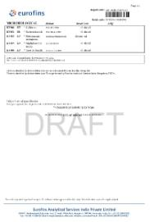
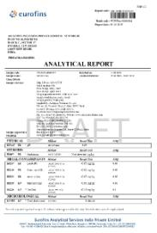

PRODUCTS ANALYTICAL REPORT BY – EUROFINS ANALYTICAL LABS

Slide 8

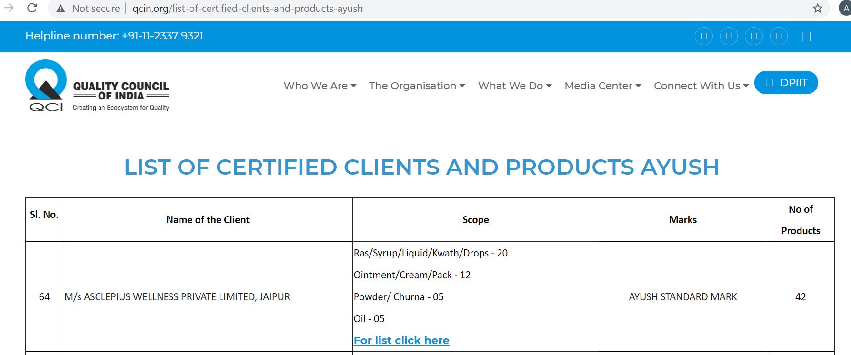

AYUSH STANDARD MARK CERTIFICATION
By QCI ( Quality Council of India )

Slide 9
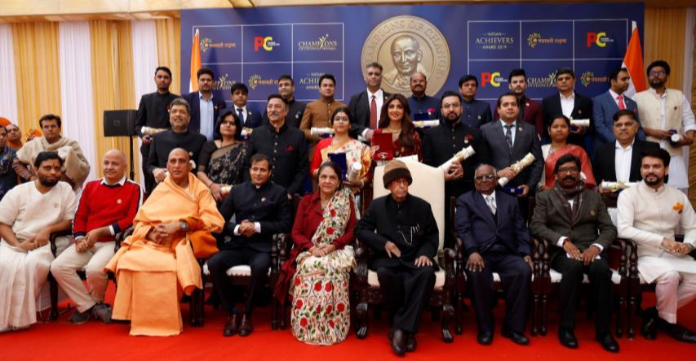
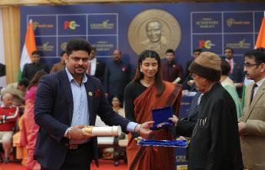
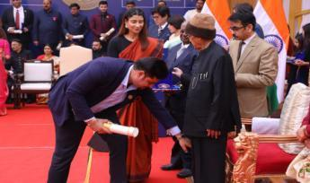
AWARDS & RECOGNITION TO COMPANY ON GLOBAL LEVEL
CHAMPIONS OF CHANGE AWARD
RECEIVED BY FORMER PRESIDENT OF NATION
( DR. PRANAB MUKHERJEE )

Slide 10
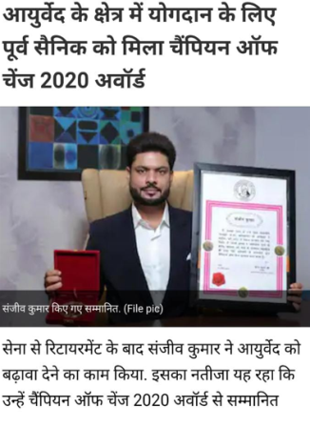

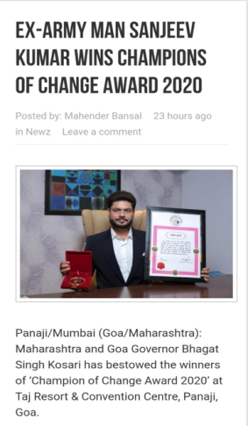
AWARDS & RECOGNITION TO COMPANY ON GLOBAL LEVEL
CHAMPIONS OF CHANGE AWARD DIGITALLY
RECEIVED BY GOVERNER OF GOA- SH. BHAGAT SINGH KOSHIYARI JI

Slide 11
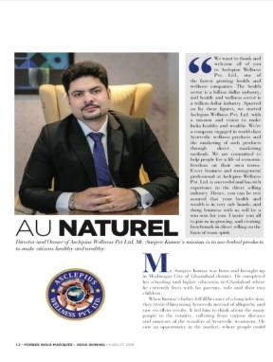


INDIAN ICON BUSINESS AWARD ( By Actress Tannaz )
MILLENIUM BRILLIANCE AWARD ( By Kangana Ranaut )
BHARAT SHAURYA SHREE AWARD
INTERNATIONAL EXCELLENCE AWARD ( By Kareena Kapoor )
SANKALP SE SIDDHI AWARD ( By Ex. Chief Justice R S Sodhi )
ASIA ONE- INDIA GREATEST BRAND AND LEADERS
INTERVIEW OF M.D IN FORBES INDIA MAGAZINE

Slide 12

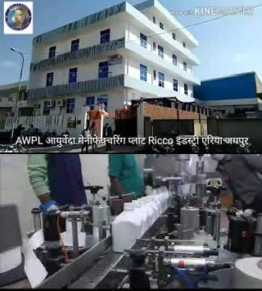







Manufacturing Unite
Jaipur
Rajastan
28th Feb 2017
Own
Manufacturing Unit
Own Research & Development
Own Lab

Slide 13
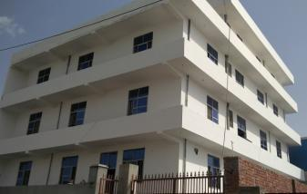
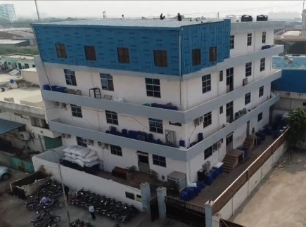
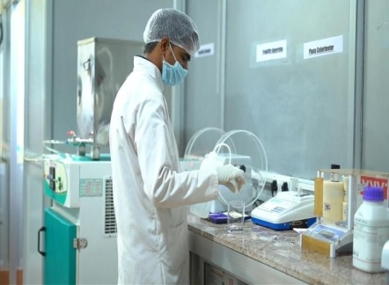
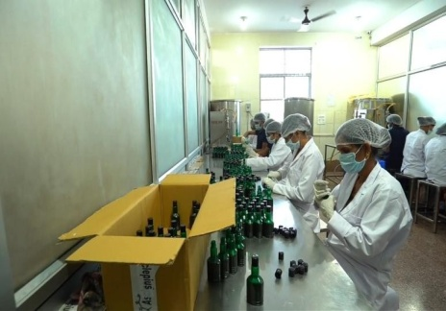
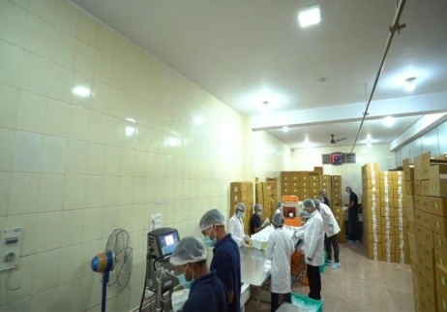
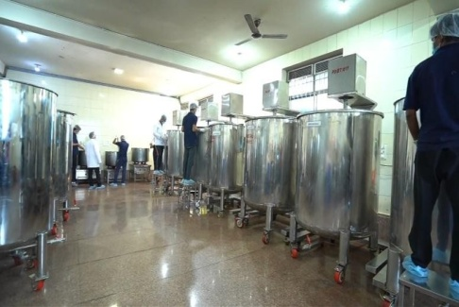
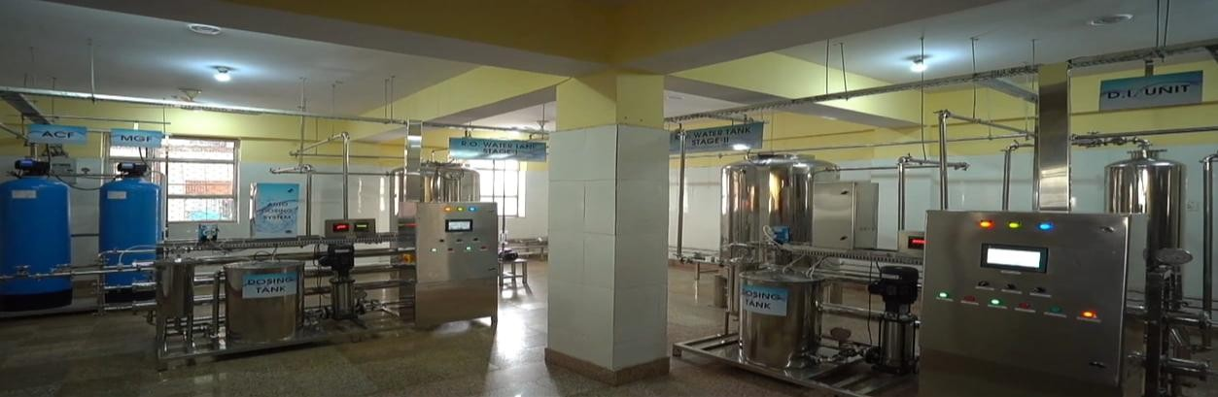
OWN MANUFACTURING UNIT
OWN MANUFACTURING UNIT
H-1, 2213, RAMCHANDRA PURA EXTENSION, Ricco Industrial Area, Sitapura, Jaipur, Rajasthan 303905

Slide 14
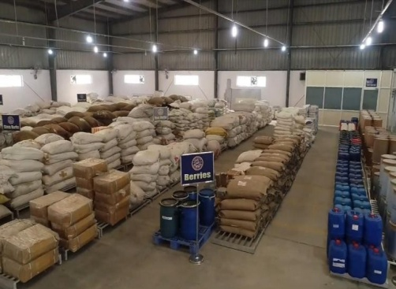
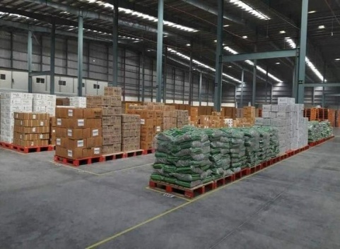
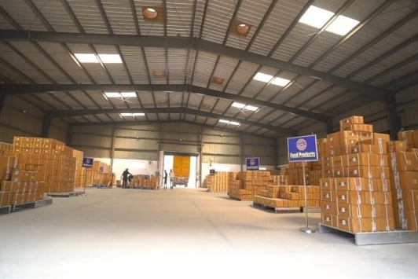

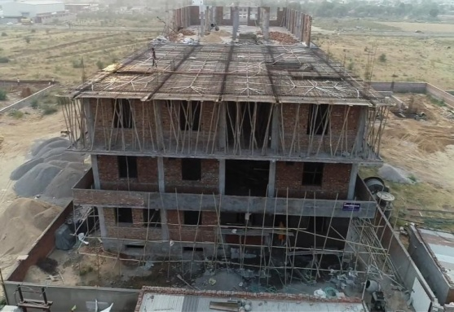
AWPL WHEREHOUSE
AWPL WORLD COMING SOON….

Slide 15


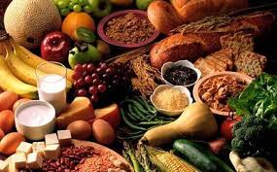
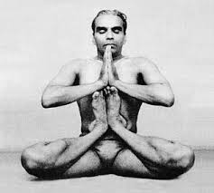

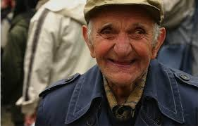


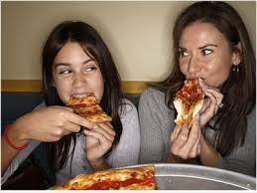


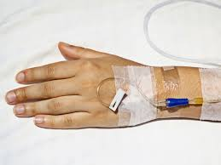
LIFE A FEW DECADES BACK AND TODAY….
OLD LIFESTYLE
LIVING LONG
DYING SHORT
NEW LIFESTYLE
LIVING SHORT
DYING LONG

Slide 16

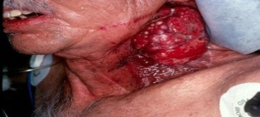
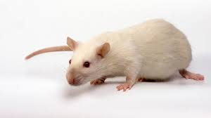

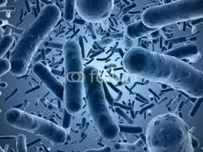



DUE TO WHICH…
OSTEOPOROSIS
ASTHMA
DIABETES
STROKE
CANCER
HYPERTENSION
CVD ( cardio-vascular-disease)
ARTHRITIS
OBESITY
ALZHEIMERS
MALARIA
DIPTHERIA
SMALLPOX
PLAGUE
CHICKEN POX
CHOLERA
TUBERCOLOSIS
WHOOPING COUGH
Cause –
Micro Organisms
Cause –
Today’s Lifestyle
Earlier Disease
Disease, Now-a-days

Slide 17
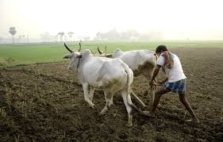


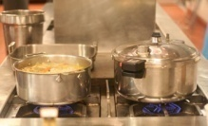






WHAT WENT WRONG?
Earlier the food what we ate was as good as Medicine.
But, Today the food what we eat is like Slow poison
Earlier
Now
Natural way of Farming Crops.
Artificial Farming
Ancient method of cooking.
Modern Cooking
No Junk / fast Foods.
Fast/Junk Food
Physical Activity was Higher.
No Physical Activity

Slide 18


CAUSE OF THESE DISEASES…..
What your body needs?
Refined products
Meat
Animal products
Boiled down vegetables
Stored fruits
Salt, Sugar, Cholesterol
Caffeine
Alcohol
Medication
Food addictive’s
Pesticides
Vitamins
Trace elements
Minerals
Carbohydrates
Fibres
Unsaturated fats
Proteins
Amino acids
Enzymes
Herbs
Water
What your body daily gets?

Slide 19









TOXINS FROM ENVIRONMENT
पर्यावरणीय विषाक्त पदार्थ
PESTICIDES IN FOOD
ARTIFICIAL RIPENING
AIR POLLUTION
RESULTS
LESS PHYSICAL ACTIVITY
WATER POLLUTION
MODERN COOKING
RADIATION
WEAK IMMUNE SYSTEM
ADULTERATION OF SPICES

Slide 20


WHAT ARE TODAY’S LIFESTYLE DISEASE..?

Slide 21


How to bring back the - Optimal Health ?
OPTIMAL HEALTH
Only Answer is
HEALTH AWARENESS TO PREVENT FROM LIFESTYLE DISEASE……
If we educate ourselves about life style disorder, then we will be healthy without any medication
Change Your lifestyle, make yourself aware about Food, Lifestyle & Lifestyle disorder.
Fulfil the nutritional Deficiency with good healthy food & ancient Ayurveda.

Slide 22

NOW, HOW TO IMPROVE IMMUNITY
OUR SOLUTION….
ELITE , NOTHING ELSE
BRINGING 5000 YRS OLD ANCIENT AYURVEDA & DELIVERING BEST QUALITY PRODUCTS.
MISSION – HEALTHY & WEALTHY INDIA

Slide 23







7 CATEGORY OF PRODUCTS
BEAUTY &
PERSONAL
CARE
ORAL CARE
HOME CARE
WELLNESS
VETERINARY CARE
FOOD SUPPLEMENT
AGRICULTURE

Slide 24


Slide 25










Asclepius Wellness Pvt. Ltd.
RELATED TO BOOSTING IMMUNITY /रोग प्रतिरोधक क्षमता बढ़ाने संबंधित

Slide 26





Asclepius Wellness Pvt. Ltd.
RELATED TO BOOSTING IMMUNITY /रोग प्रतिरोधक क्षमता बढ़ाने संबंधित

Slide 27







RELATED TO ANTI DIABETIC / मधुमेह से संबंधित

Slide 28




RELATED TO BONE & JOINT HEALTH / हड्डी और जोड़ों से संबंधित

Slide 29








RELATED TO ANTIOXIDANT & ANTI-INFLAMMATORY / एंटीऑक्सीडेंट और एंटी-इन्फ्लैमेटरी से संबंधित

Slide 30







RELATED TO ANTI OBESITY / मोटापा से संबंधित

Slide 31


RELATED TO ANTI PILES / बवासीर से संबंधित

Slide 32





RELATED TO ANTI ALLERGIC / एलर्जी से संबंधित

Slide 33





RELATED TO BRAIN HEALTH / मस्तिष्क स्वास्थ्य से संबंधित

Slide 34





RELATED TO CARDIAC/HEART CARE / कार्डिएक/हृदय देखभाल से संबंधित

Slide 35


RELATED TO DAILY HEALTH FOOD / दैनिक स्वास्थ्य से संबंधित

Slide 36

RELATED TO HYPERTENSION / उच्च रक्तचाप से संबंधित

Slide 37


RELATED TO LIVER SUPPORT / लीवर सपोर्ट से संबंधित

Slide 38


RELATED TO KIDNEY & UTI / किडनी और यूटीआई से संबंधित

Slide 39



RELATED TO KIDS HEALTH / बच्चों के स्वास्थ्य से संबंधित

Slide 40


RELATED TO THYROID SUPPORT / थायराइड से संबंधित

Slide 41




RELATED TO RESPIRATORY / श्वसन से संबंधित

Slide 42






RELATED TO WOMEN WELLNESS / वूमन वैलनेस से संबंधित

Slide 43












RELATED TO VIRAL & INFECTIOUS DISEASE /वायरल और संक्रामक रोग से संबंधित

Slide 44



RELATED TO SEXUAL WELLNESS / सेक्सुअल वैलनेस से संबंधित

Slide 45




RELATED TO PERSONAL CARE / पर्सनल केयर देखभाल से संबंधित

Slide 46


RELATED TO PERSONAL CARE / पर्सनल केयर देखभाल से संबंधित

Slide 47




RELATED TO PERSONAL HYGEINE / स्वच्छता से संबंधित

Slide 48





RELATED TO SKIN CARE / त्वचा की देखभाल से संबंधित

Slide 49


RELATED TO DE-ADDICTION / नशामुक्ति से संबंधित

Slide 50



RELATED TO HAIR CARE / बालों की देखभाल से संबंधित

Slide 51





RELATED TO DAILY NUTRITION / दैनिक पोषण से संबंधित

Slide 52

RELATED TO DIGESTIVE HEALTH / पाचन स्वास्थ्य से संबंधित

Slide 53

RELATED TO EYE HEALTH / नेत्र समस्या संबंधित

Slide 54



RELATED TO MUSCLE SUPPORT / मसल पावर संबंधित

Slide 55

RELATED TO ORAL CARE / ओरल केयर संबंधित

Slide 56

RELATED TO AMINO ACID / अमीनो एसिड से संबंधित

Slide 57






RELATED TO AGRICULTURE / कृषि से संबंधित

Slide 58





MAKEUP MANTRAS

Slide 59




MAKEUP MANTRAS

Slide 60




RELATED TO HOME CARE / होम केयर से संबंधित

Slide 61



RELATED TO HOME CARE / होम केयर से संबंधित

Slide 62


RELATED TO VETERINARY CARE

Slide 63


AWPL MARKETING PLAN
WEALTH
OPPORTUNITY
FOR EVERYONE
- BY -
ASCLEPIUS
WELLNESS PVT. LTD.

Slide 64

WHY YOU HAVE TO JOIN ASCLEPIUS WELLNESS ??
TO GET WORLD CLASS BEST “AYURVEDIC PRODUCT” .
A GOLDEN “BUSINESS OPPORTUNITY”.
YOU WILL GET LIFE TIME 20% RETAIL PROFIT .

Slide 65
STARTUP PROCESS
AGE 18+, MOBILE NUMBER, EMAIL ID, GOVERNMENT ID PROOF.
YOU CAN START THIS BUSINESS WITH –
27 SP, 52 SP, 100 SP
27 SP WEEKLY INCOME CAPLIMIT – Rs.75,000/-
52 SP WEEKLY INCOME CAPLIMIT – Rs.1.5 LAKH/-
100 SP WEEKLY INCOME CAPLIMIT – Rs 2 LAKHS +

Slide 66

TO START
1
300SP – 3ID
45,000/- to 50,000/-
FAMILY JOINING

Slide 67

TO START
2
200SP – 2 ID
32,000/- to 35,000/-
COUPLE JOINING

Slide 68


TO START
3
100SP – 1 ID
16,000/- to 18,000/-
SINGLE JOINING

Slide 69

Life Long Benefits
After become a Distributor
Whole life Discount

Slide 70

HOW THE NETWORK WILL CREATE IN YOUR BUSINESS?
S.A.O - SALES ACHIEVEMENT ORGANISATION
S.G.O – SALES GENERATION ORGANISATION
You
SAO
A
B
SGO
C
D

Slide 71
BY CREATING NETWORK IN AWPL ?
6 TYPE BENEFIT OF OUR CONCEPT AND MATHEMATICALLY
CALCULATED BUSINESS PLAN.
20% Retail Profit
SALES COMMISSION (Weekly)
MONTHLY SALES PERFORMANCE COMMISSION
STAR SALES LEADERSHIP COMMISSION
AMBASSADOR CLUB LEADERSHIP COMMISSION
TRIP ACHIEVEMENT (As per Level Achieved)
IF 1 SP = 160 - 170 /- APPROX.
DISTRIBUTION = 102 /-
(IN THESE COMMISSION WITH MATHEMATICALLY CALCULATION )

Slide 72

RETAIL PROFIT
DP
UPTO 20% MARGIN
MRP
GET 20% RETAIL PROFIT FOR LIFETIME FROM 1st DAY

Slide 73
EQUIVALENT INCOME
PER 100 SP MATCH FROM S.A.O & S.G.O YOU WILL GET 1000 /-
Week | S.A.O | S.G.O | Income
1. | 100 SP | 100 SP | 1000 /-
2. | 200 SP | 200 SP | 2000 /-
3. | 700 SP | 300 SP | 3000/-
4. | 0SP | 400 SP | 4000 /-
5. | 20000 SP | 20000SP | 200000/-
NO LAPSING OF SALES , YOU WILL GET INCOME OF EVERY SALES POINT YOU COLLECT IN YOUR BUSINESS .
WEDNESDAY CLOSING -- YOU WILL GET YOUR INCOME INTO YOUR AC BY THURSDAY

Slide 74
ALL RANK LEVELS AND INCOME
NO. | RANK | SAO <LEFT> | SGO <RIGHT> | MACHING BONUS | RANK BONUS | TOTAL
1. | BRONZE | 200 SP | 100 SP | 1,000 | 1,500 | 2,500
2. | SILVER | 600 SP | 300 SP | 3,000 | 4,500 | 7,500
3. | GOLD | 1200 SP | 600 SP | 6,000 | 9,000 | 15,000
4. | PLATINUM | 2400 SP | 1200 SP | 12,000 | 20,000 | 32,000
5. | EMERALD | 4800 SP | 2400 SP | 24,000 | 45,000 | 69,000

Slide 75

NO. | RANK | SAO <LEFT> | SGO <RIGHT> | MACHING BONUS | RANK BONUS | TOTAL INCOME
6. | TOPAZ | 12000 SP | 6000 SP | 60,000 | 1,50,000 | 2,10,000
3N / 4D
THAILAND TRIP
SELF
FREE OF COST THAILAND TRIP:-

Slide 76
NO. | RANK | SAO <LEFT> | SGO <RIGHT> | MACHING BONUS | RANK BONUS | TOTAL INCOME
7. | RUBY STAR | 24000 SP | 12000 SP | 1,20,000 | 2,30,000 | 3 LAKHS

Slide 77


NO. | RANK | SAO <LEFT> | SGO <RIGHT> | MACHING BONUS | RANK BONUS | TOTAL INCOME
8. | SAPPHIRE | 48000 SP | 24000 SP | 2,40,000 | 3,60,000 | 6 LAKHS
3N / 4D
DUBAI TRIP
COUPLE + 2 CHILD
FREE OF COST DUBAI FAMILY TRIP:-

Slide 78

NO. | RANK | SAO <LEFT> | SGO <RIGHT> | MACHING BONUS | RANK BONUS | TOTAL INCOME
9. | STAR SAPPHIRE | 96000 SP | 48000 SP | 4,80,000 | 8,20,000 | 13 LAKHS
4N / 5D
MALESIA SELF TRIP
FREE OF COST SELF MALESIA TRIP:-

Slide 79

NO. | RANK | SAO <LEFT> | SGO <RIGHT> | MACHING BONUS | RANK BONUS | TOTAL INCOME
10. | DIAMOND | 192000 SP | 96000 SP | 9,60,000 | 12,40,000 | 22 LAKHS
3N / 4D
ANDAMAN NICOBAR ISLANDS COUPLE TRIP
LADIES AND HANDICAP 5,00,000 EXTERA

Slide 80



NO. | RANK | SAO <LEFT> | SGO <RIGHT> | MACHING BONUS | RANK BONUS | TOTAL INCOME
11. | BLUE DIAMOND | 384000 SP | 192000 SP | 19,20,000 | 22,00,000 | 41.2 LAKHS
5N / 6D
SWITZERLAND
TRIP, COUPLE + 2 CHILD
FAMILY SWITZERLAND TRIP

Slide 81

NO. | RANK | SAO <LEFT> | SGO <RIGHT> | MACHING BONUS | RANK BONUS | TOTAL INCOME
12. | BLACK DIAMOND | 768000 SP | 384000 SP | 38,40,000 | 35,00,000 | 73.4 LAKHS
4N / 5D
PETERSBURG RUSSIA SELF TRIP
SELF RUSSIA TRIP

Slide 82

NO. | RANK | SAO <LEFT> | SGO <RIGHT> | MACHING BONUS | RANK BONUS | TOTAL INCOME
13. | ROYAL DIAMOND | 15360000 SP | 768000 SP | 76,80,000 | 59,00,000 | 1.35 CR
5N / 6D
SINGAPORE / MALAYSIA
COUPLE + 2 CHILD
FAMILY TRIP SINGAPORE/MALAYSIA

Slide 83

NO. | RANK | SAO <LEFT> | SGO <RIGHT> | MACHING BONUS | RANK BONUS | TOTAL INCOME
14. | CROWN DIAMOND | 3072000 SP | 1536000 SP | 1,53,60,000 | 93,00,000 | 2.6CR
5N / 6D
MUSCAT/FIZI
COUPLE + 2 CHILD
5N / 6D
MUSCAT/FIZI
COUPLE + 2 CHILD
FAMILY TRIP MUSCAT/FIZI

Slide 84

NO. | RANK | SAO <LEFT> | SGO <RIGHT> | MACHING BONUS | RANK BONUS | TOTAL INCOME
15. | AMBASSADOR | 6144000 SP | 3072000 SP | 30720000 | 1,50,00,000 | 4.5 CR
5N/6D
AUSTRALIA TRIP
SELF
5N / 6D
MUSCAT/FIZI
COUPLE + 2 CHILD
SELF AUSTRALIA TRIP

Slide 85

NO. | RANK | SAO <LEFT> | SGO <RIGHT> | MACHING BONUS | RANK BONUS | TOTAL INCOME
16. | ROYAL AMBASSADOR | 12288000 SP | 6144000 SP | 61440000 | 2,85,00,000 | 8.9 CR
17. | CROWN AMBASSADOR | 24576000 SP | 12288000 SP | 122880000 | 5,50,00,000 | 17.7 CR
18. | BRAND AMBASSADOR | 49152000 SP | 24576000 SP | 245760000 | 12,0000000 | 36.5 CR
5N/6D AUSTRALIA TRIP COUPLE + 2 CHILD
TOTAL INCOME | APPROX. | Rs. 73,37,86,000

Slide 86


THIS IS THE POWER OF
TCS
METHOD

Slide 87










FLIGHT
HOTELS
BANK BALANCE
FULFILL YOUR
DREAMS
WITH DEARLIFE LOGO
INTERNATIONAL
TRIPS
MOBILES
LAPTOPS
FLATS
BIKES
CARS

Slide 88









Family Security

Slide 89







THREE GENERATION FAMILY
SECURITY
ASCLEPIUS
WELLNESS
NOMINEE
SAO - TEAM
SGO -TEAM
300 Direct Seller
150 Direct Seller

Slide 90
AWPL FOUNDATION WELFARE FUND
NO. | RANK | WELFARE FUND
1. | EMERALD | 1 LAKHS
2. | TOPAZ | 2 LAKHS
3. | RUBY STAR | 3 LAKHS
4. | SAPPHIRE | 4 LAKHS
5. | STAR SAPPHIRE | 8.20 LAKHS
6. | DIAMOND | 12.40 LAKHS
7. | BLUE DIAMOND | 22 LAKHS
AWPL FOUNDATION WILL PROVIDE EDUCATION FEE FOR 2 CHILDREN UPTO 12th CLASS

Slide 91

Now its time To TAKE Decision
Questions
Feel free to ask us your questions, after session .

Slide 92


1
Right Decision
Change the FUTURE
Our Support System

Slide 93


Thank You!
ASCLEPIUS WELLNESS PRIVATE LIMITED
Plot No. 18, Pocket-8, Block-C, Near HDFC Bank, Sector-17, Dwarka, New Delhi - 110075
GSTIN. No. : 07AAMCA9419N1Z0 | CIN : U51909DL2014PTC272296
Tel. : +91 11 28033739 | Email : customercare@asclepiuswellness.com | Web : www.asclepiuswellness.com

